Slide 1

Tata Motors: Driving the Future of Mobility
Join us as we explore the journey of Tata Motors, a global automotive powerhouse committed to innovation, sustainability, and shaping the future of transportation.

Slide 2




Our Legacy: A Century of Innovation
Established in 1945, Tata Motors has grown from a manufacturer of locomotives to a leading global automotive company. Our journey is marked by a relentless pursuit of innovation and a commitment to engineering excellence.
1945: Inception
1
Founded as a locomotive manufacturer.
2
1954: Automotive Foray
Partnership with Daimler-Benz, entering commercial vehicle production.
1980s: Passenger Vehicle Entry
3
Launch of India's first indigenous passenger car.
4
2008: Global Expansion
Acquisition of Jaguar Land Rover, marking a significant global presence.

Slide 3

Global Footprint: Expanding Horizons
Tata Motors has a vast global presence, with manufacturing facilities, research and development centres, and sales networks spanning across continents. Our international operations are a testament to our ambition and ability to cater to diverse markets.
India Base
Manufacturing and R&D hubs
Europe Hubs
Manufacturing and sales presence
Asia Reach
R&D centres and sales networks
Africa Markets
Sales operations and support
We are committed to delivering world-class products and services to customers worldwide, adapting to local needs and preferences.

Slide 4
Product Portfolio: From Nano to Nexon EV
Our diverse product range caters to a wide spectrum of customer needs, from affordable urban mobility solutions to luxurious premium vehicles and cutting-edge electric models.
Tata Nano
Tata Altroz
Tata Safari
Tata Nexon EV
The 'People's Car', revolutionising affordable mobility.
Premium hatchback offering style, safety, and performance.
Iconic SUV, known for its ruggedness and comfort.
Leading the electric vehicle revolution in India.

Slide 5

Electrifying the Future: Our EV Strategy
Tata Motors is at the forefront of the electric vehicle (EV) revolution in India, committed to sustainable mobility. Our comprehensive EV strategy encompasses product development, charging infrastructure, and ecosystem partnerships.
Advanced Powertrains: Developing high-performance, long-range electric powertrains.
Robust Charging Network: Building a widespread public and home charging infrastructure.
Ecosystem Partnerships: Collaborating with energy providers and technology firms.
Affordable EVs: Making electric vehicles accessible to a wider audience.

Slide 6
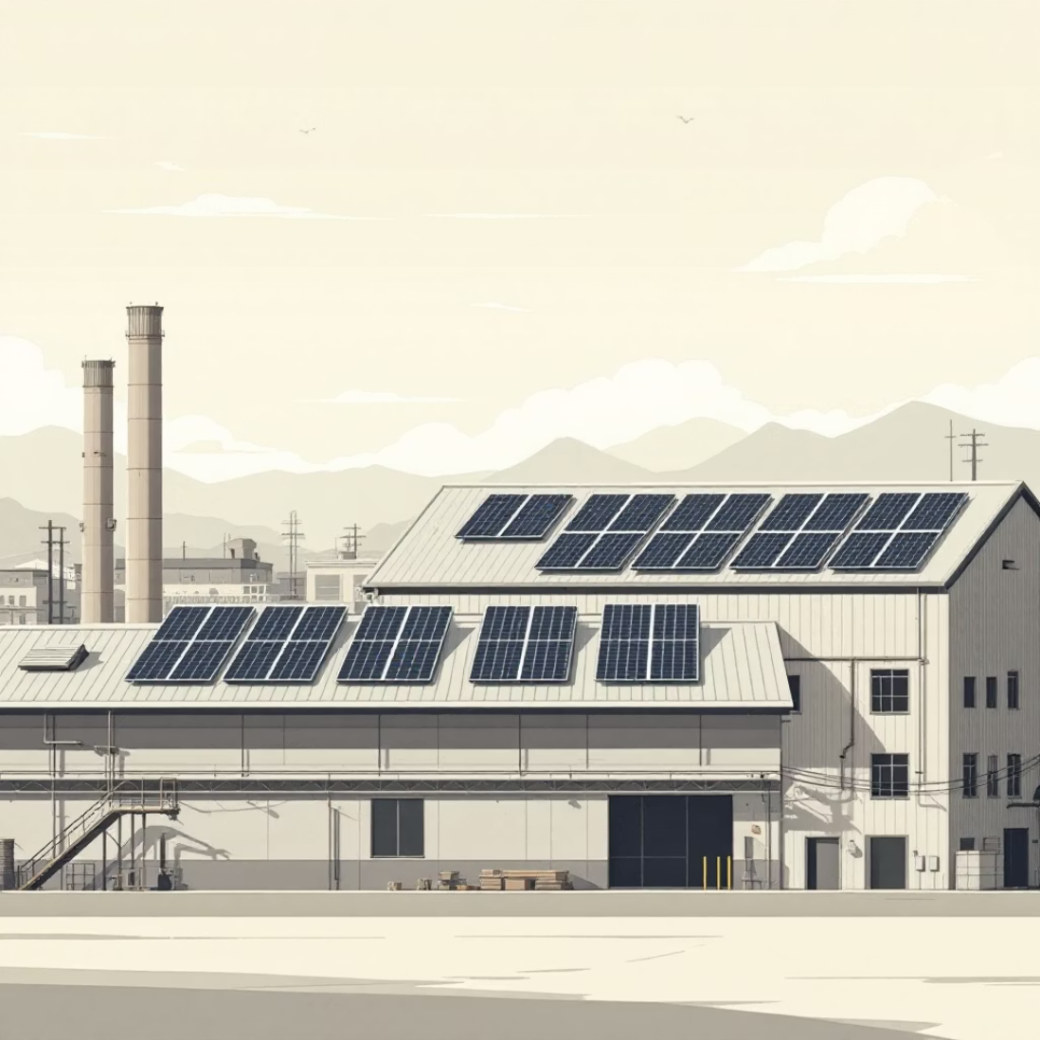


Sustainability Initiatives: Greener Tomorrow
Beyond EVs, Tata Motors is dedicated to a holistic approach to environmental sustainability. We are implementing various initiatives to reduce our ecological footprint across our operations and supply chain.
Renewable Energy
Water Conservation
Afforestation Programs
Increasing the use of solar and wind energy in our manufacturing plants.
Implementing advanced water recycling techniques to minimise consumption.
Engaging in large-scale tree plantation drives to offset carbon emissions.
Our commitment extends to promoting sustainable practices throughout our entire value chain.

Slide 7
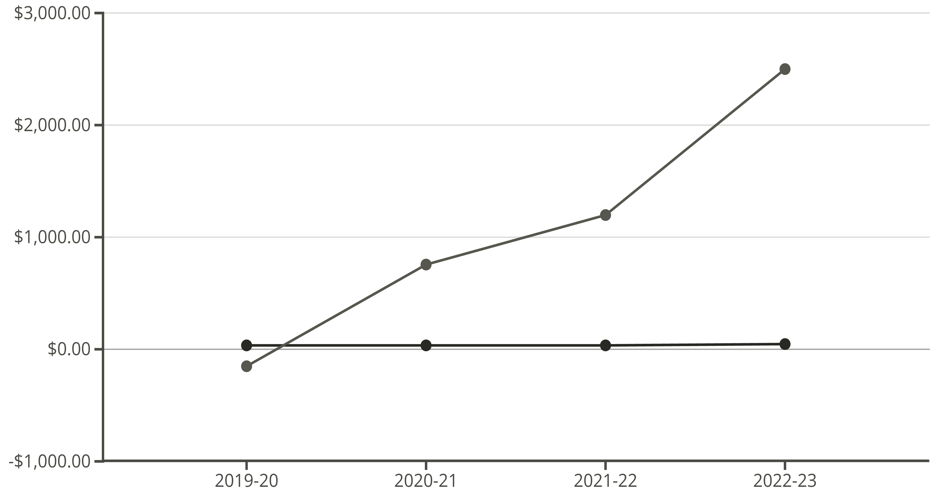
Financial Performance: Growth and Resilience
Tata Motors has demonstrated strong financial growth and resilience, navigating challenging market conditions while investing in future technologies. Our consistent performance reflects our robust business model and strategic vision.
Revenue (Billion GBP)
Net Profit (Million GBP)
The chart illustrates a clear upward trend in revenue and a significant recovery in net profit over the last four financial years, highlighting the company's financial turnaround and growth trajectory.

Slide 8


Challenges and Opportunities: Navigating the Landscape
The automotive industry is dynamic, presenting both significant challenges and exciting opportunities. Tata Motors is strategically positioned to address these head-on.
Challenges
Opportunities
Supply chain disruptions.
Growing EV market demand.
Intense competition.
Focus on connected vehicles.
Rapid technological shifts.
Expansion into emerging markets.
Fluctuating raw material costs.
Leveraging advanced manufacturing.
By embracing innovation and agile strategies, we aim to transform challenges into pathways for growth.

Slide 9
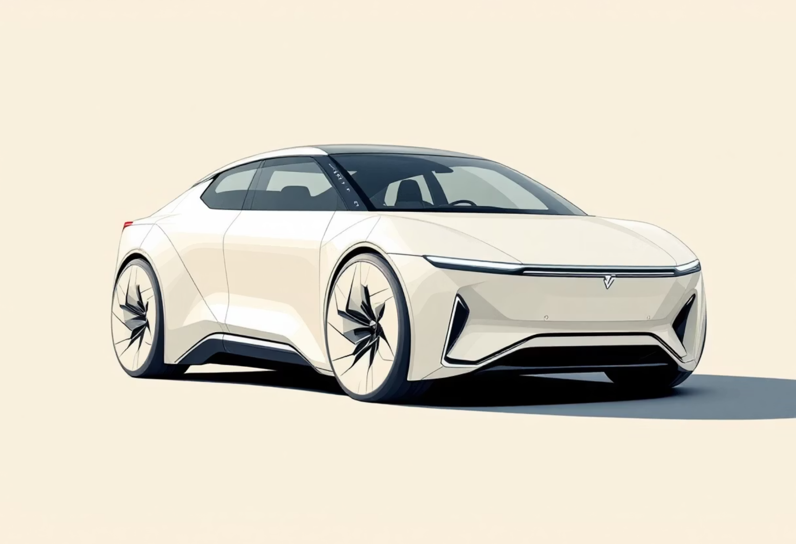
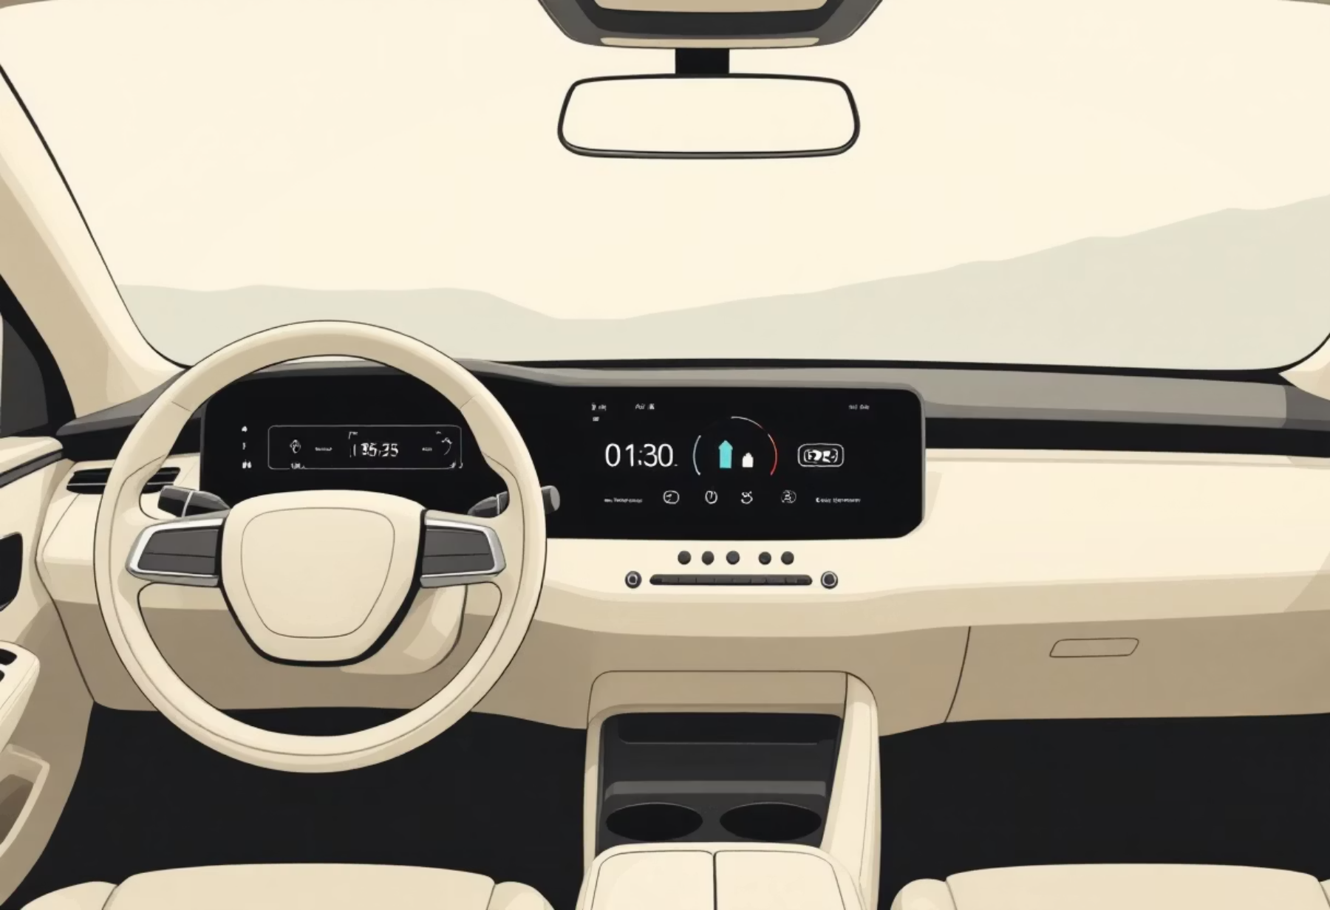
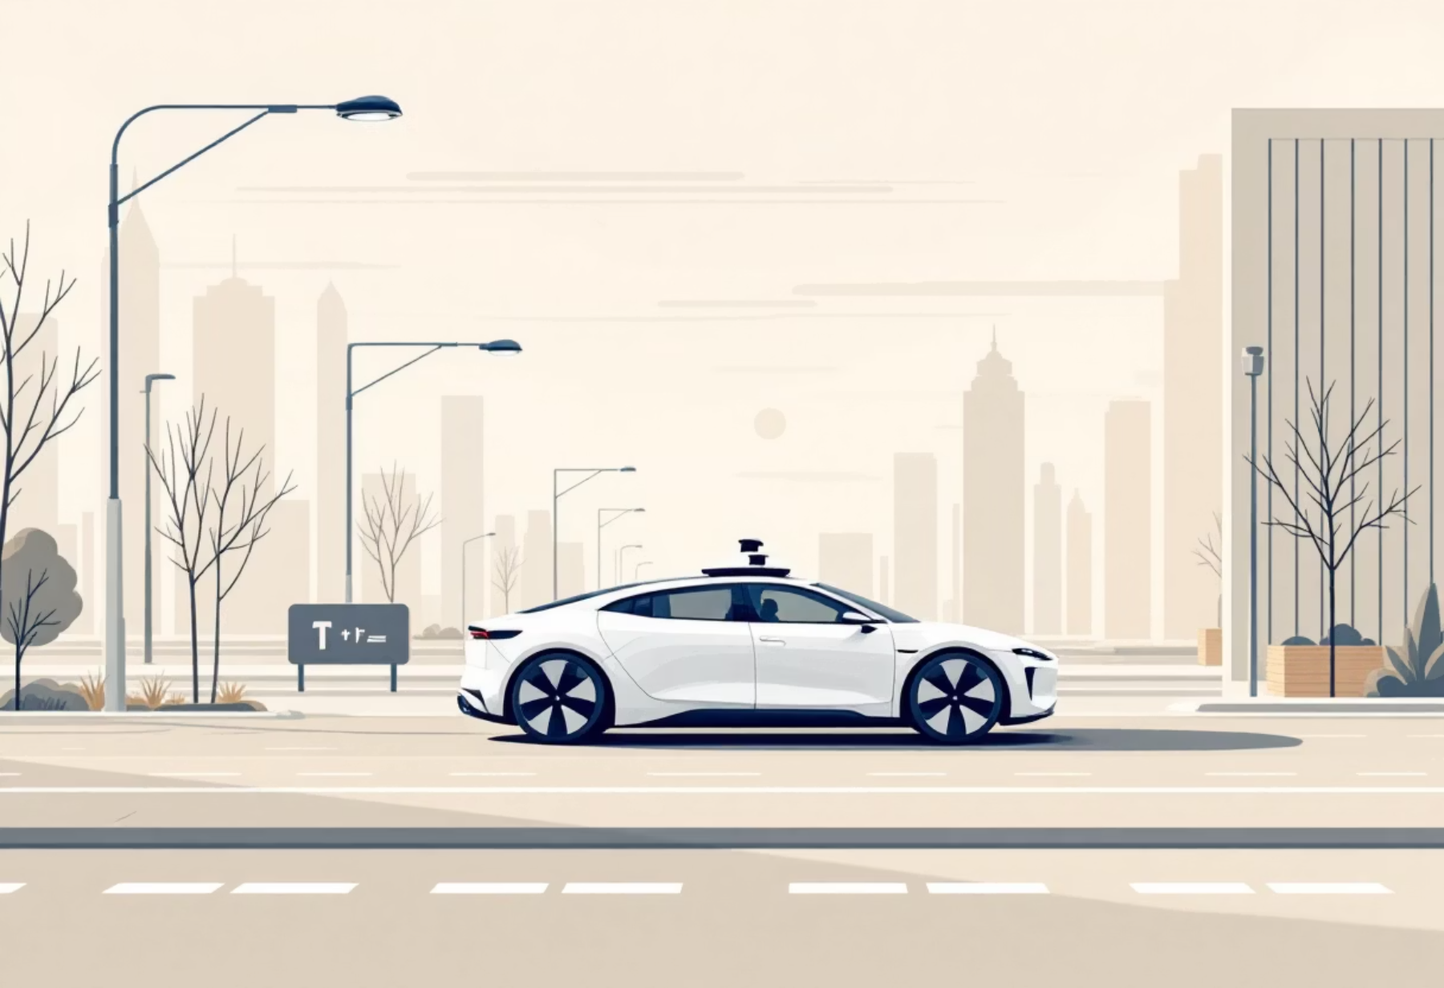

Vision for 2030: Shaping the Next Decade
Our vision for 2030 is to be a leader in sustainable and connected mobility, creating a positive impact on the environment and society. We are committed to pioneering new technologies and solutions.
01
02
Accelerated EV Adoption
Advanced Connected Features
Aiming for 50% EV penetration in our passenger vehicle sales.
Integrating AI and IoT for enhanced driving experiences.
03
04
Autonomous Driving Development
Circular Economy Principles
Investing in research and development for autonomous vehicle technology.
Implementing sustainable materials and recycling processes.

Slide 10

Q&A: Your Questions, Our Answers
We appreciate your attention and interest in Tata Motors. We are now open to your questions and look forward to a stimulating discussion about our future.
Thank you for being part of our journey towards a more sustainable and innovative future.

